Slide 1


Distributed Cloud Firewall
ACE Solutions Architecture Team

Slide 2


As Architected with Lift-and-Shift, Bolt-on, Data Center Era Products…
Internet
Internet
“Last Generation Firewalls”

Slide 3
In Reality…
Internet
Internet
Internet
Internet
Internet
Internet

Slide 4
What If… the architecture was built for cloud
Internet
Internet
Internet
Internet
Internet
Internet

Slide 5

Firewalling Functions were Embedded in the Cloud Network Everywhere…
Internet
Internet
Internet
Internet
Internet
Internet
How companies are navigating the network security is an obstacle course in 2024

Slide 6
Centrally Managed, with Distributed Inspection & Enforcement…
Internet
Internet
Internet
Internet
Internet
Internet

Slide 7






And, What If it was more than just firewalling…
Internet
Internet
Internet
Distributed
Firewalling
Internet
IDS / IPS
NSG
Micro-Segmentation
Advanced NAT
Threat Prevention
Internet
Decryption
URL
Filtering
Internet

Slide 8
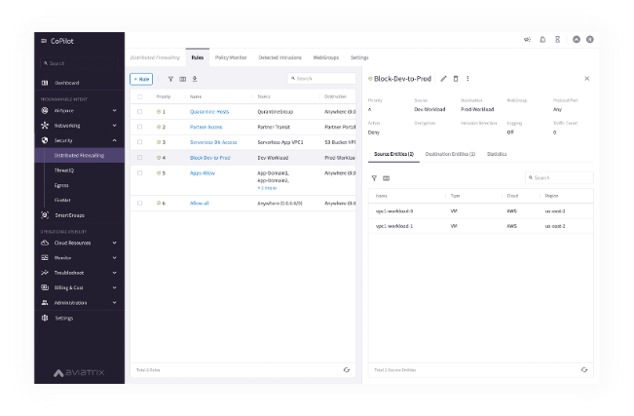



Policy Creation Looked Like One Big Firewall … A Distributed Cloud Firewall…
Where and How Policies Are Enforced Is Abstracted…

Slide 9



Smart Group
What is a Smart Group?
A Smart Group identifies a group of resources that have similar policy requirements, that are confined in the same logical container.
The members of a Smart Group can be classified using three methods:
CSP Tags
Case Sensitive
Resource Attributes
CIDR

Slide 10
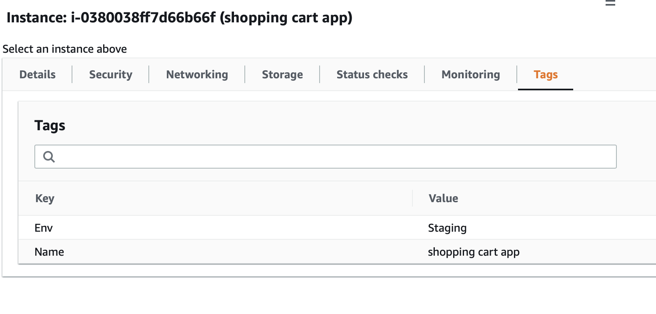
Classification Methods
CSP Tags (recommended)
Tags are assigned to:
Instance
VPC/VNET
Subnet
Tags are {Key, Value} pairs
Eg: A VM hosting shopping cart application can be tagged with:
{Key: Type, Value: Shopping cart app}
{Key: Env, Value: Staging}
Resource attribute
Region Name, Account Name
IP Prefixes
CIDR

Slide 11






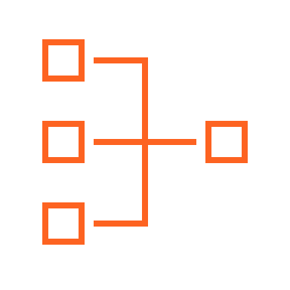

Distributed Firewalling: Intra-rule vs. Inter-rule
Smart Groups
VPC
VPC
VNet
VNet
Apache
Nginx
VPC
VPC
VNet
VNet
A rule between SGs can be defined for achieving the INTER-SMARTGROUP communication
Region 1
Region 2
Region 1
Region 2
INTRA-RULE: is defined within a Smart Group, for dictating what kind of traffic is allowed/prohibited among all the instances that belong to that Smart Group
INTER-RULE: is defined among Smart Groups, for dictating what kind of traffic is allowed/prohibited among two or more Smart Groups.

Slide 12
Network Segmentation & Distributed Cloud Firewall Rule
Network Domains
Smart Groups
Network Domains
Smart Groups
LOB1
LOB2
Apache
Nginx
LOB1
LOB2
Apache
Nginx
VPC
VPC
VNet
VNet
VPC
VPC
VNet
VNet
A rule between SGs can be defined for achieving the INTER-SMARTGROUP communication
Region 1
Region 2
Region 1
Region 2
Scenario #1:
Intra-rule is applied within a SmartGroup defined in the same Network Segment
Inter-rule is applied between SmartGroups within the same network Domain
Scenario #2:
Intra-rule is applied within a SmartGroup defined across two different Network Domains
Inter-rule is applied between SmartGroups defined across two different network Domains
Caveat:
Network Segmentation and Distributed Firewalling are NOT mutually exclusive!
Network Segmentation takes precedence over the extent of a SmartGroup
12

Slide 13
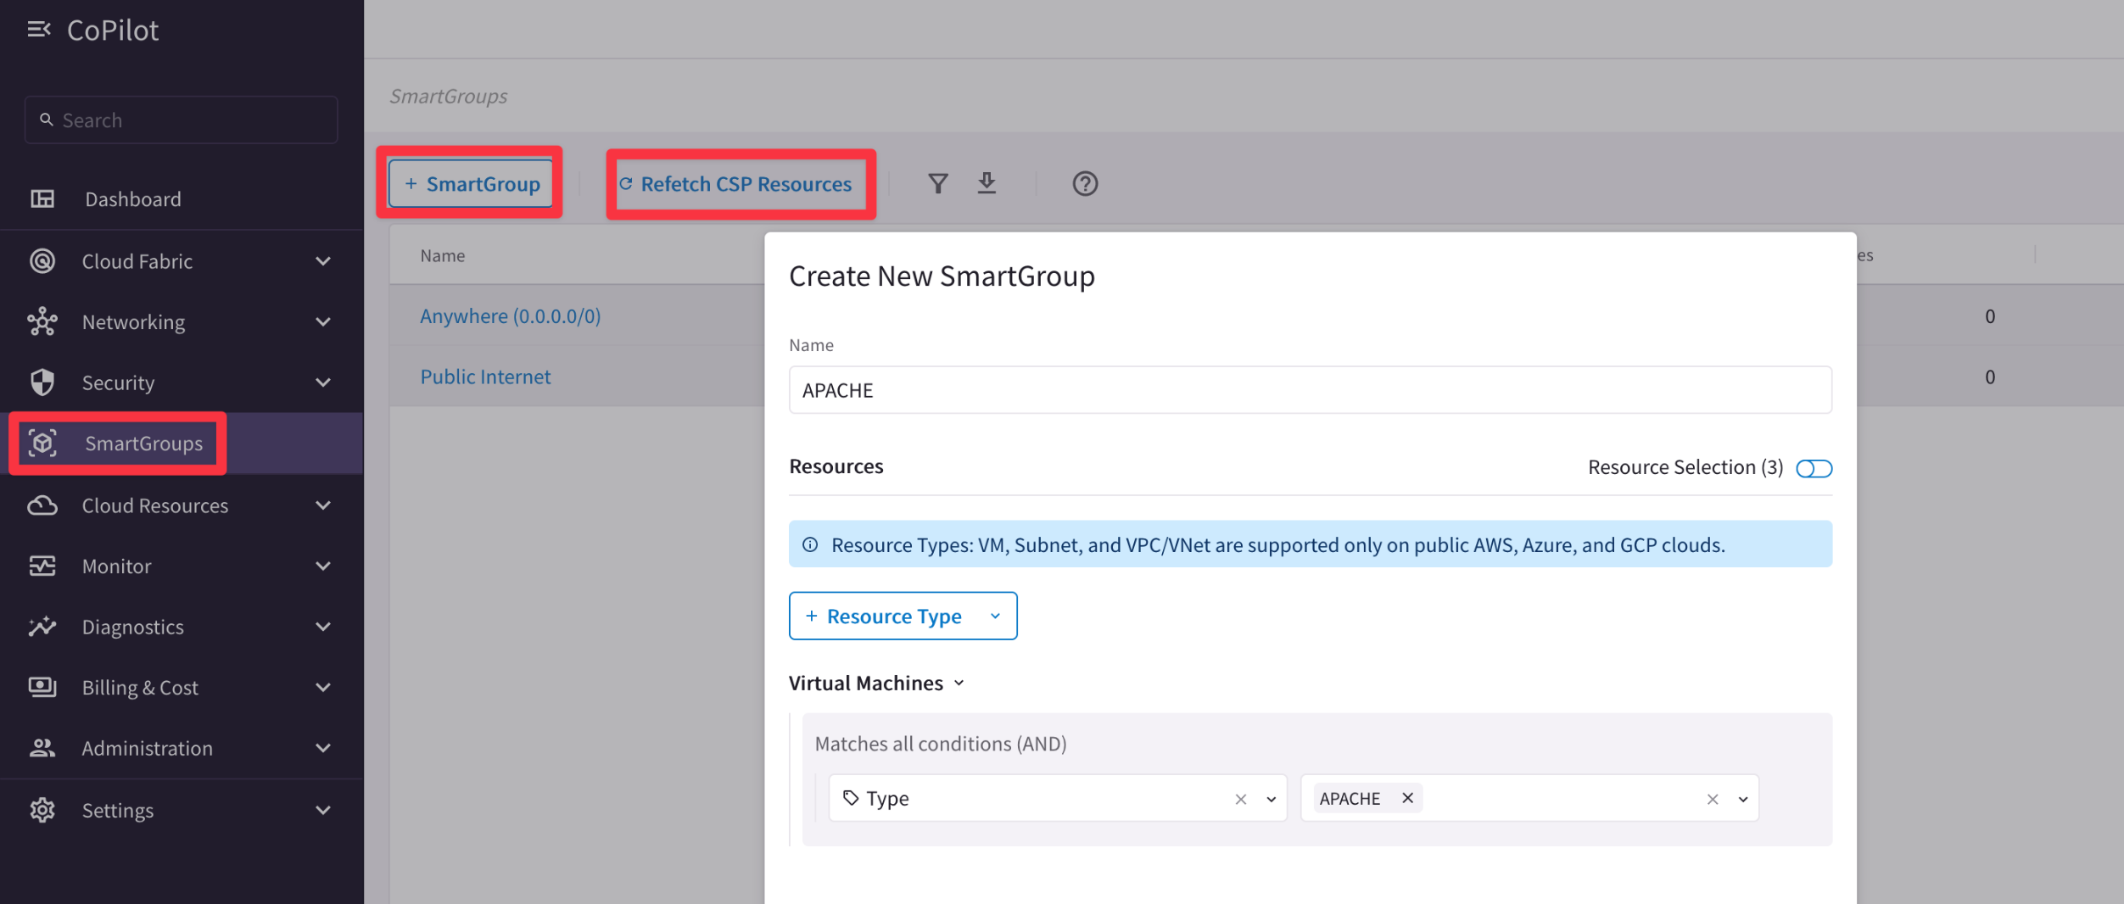

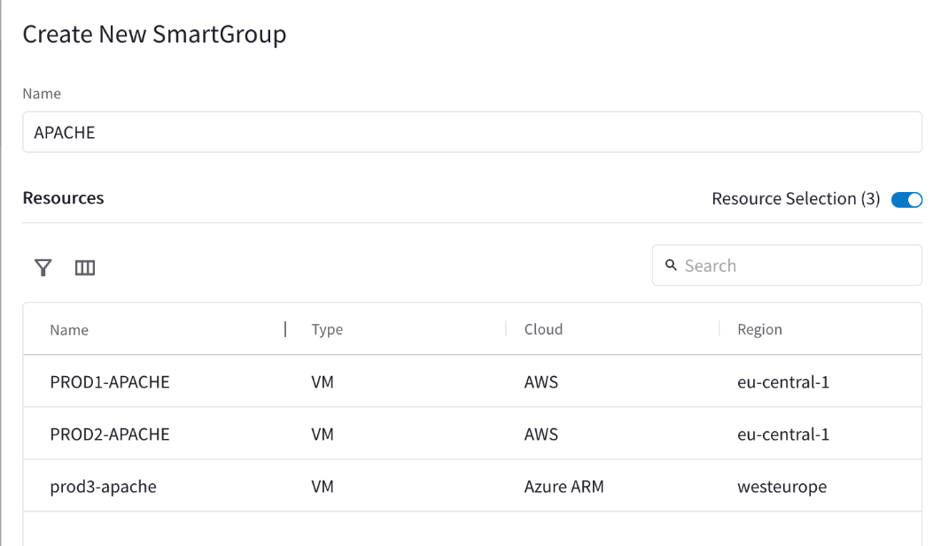
Smart Groups Creation
Controller polls the CSPs to retrieve inventory (about VPCs, instances etc.) every 15 minutes (can be modified)
CoPilot queries Controller every 1 hour (can be modified)
On-demand refresh of tags is available

Slide 14
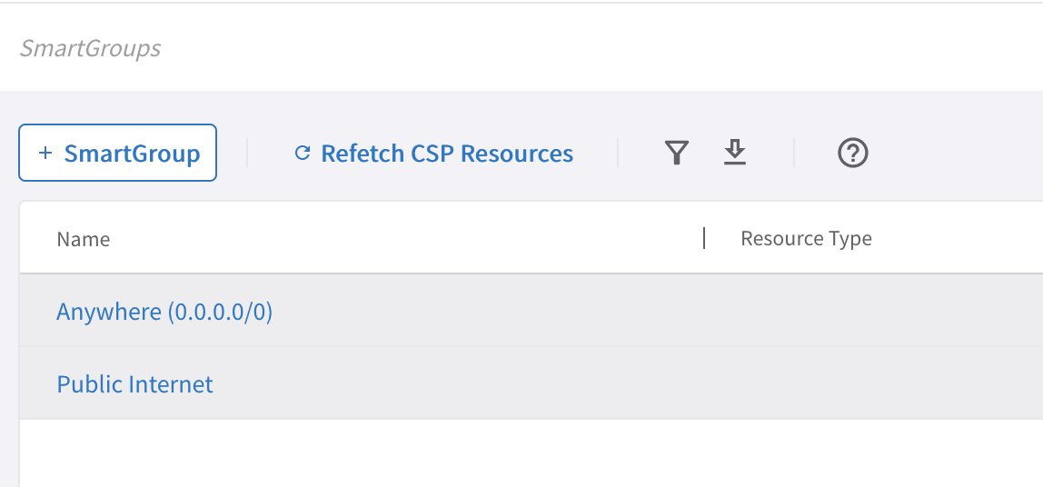
Pre-defined Smart Groups
Anywhere (0.0.0.0/0) → RFC1918 routes + Default Route (IGW)
Public Internet → Default Route (IGW)

Slide 15
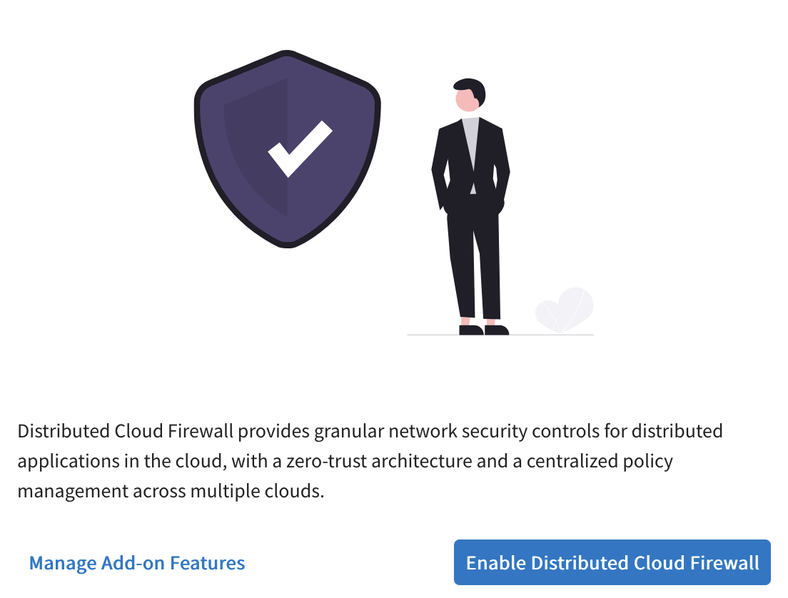
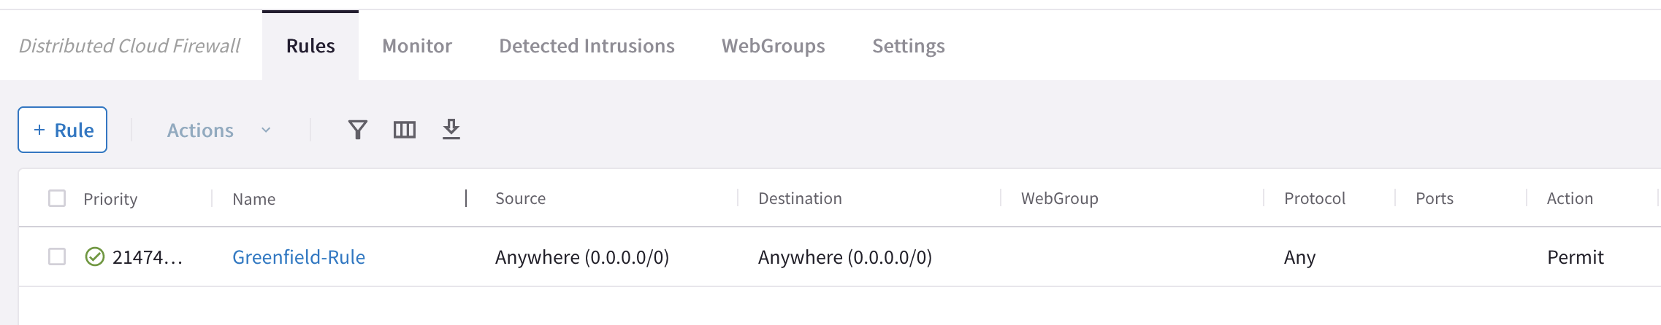
Enabling Distributed Cloud Firewall
Enabling the Distributed Cloud Firewall without configured rules will deny all previously permitted traffic due to its implicit Deny All rule.
To maintain consistency, a Greenfield Rule will be created to allow traffic that maintains the current state, facilitating the creation of custom rules for specific security needs.
DENY LIST MODEL (THREAT-CENTRIC MODEL):
allow all data to flow, except for exactly what you say should be stopped.

Slide 16
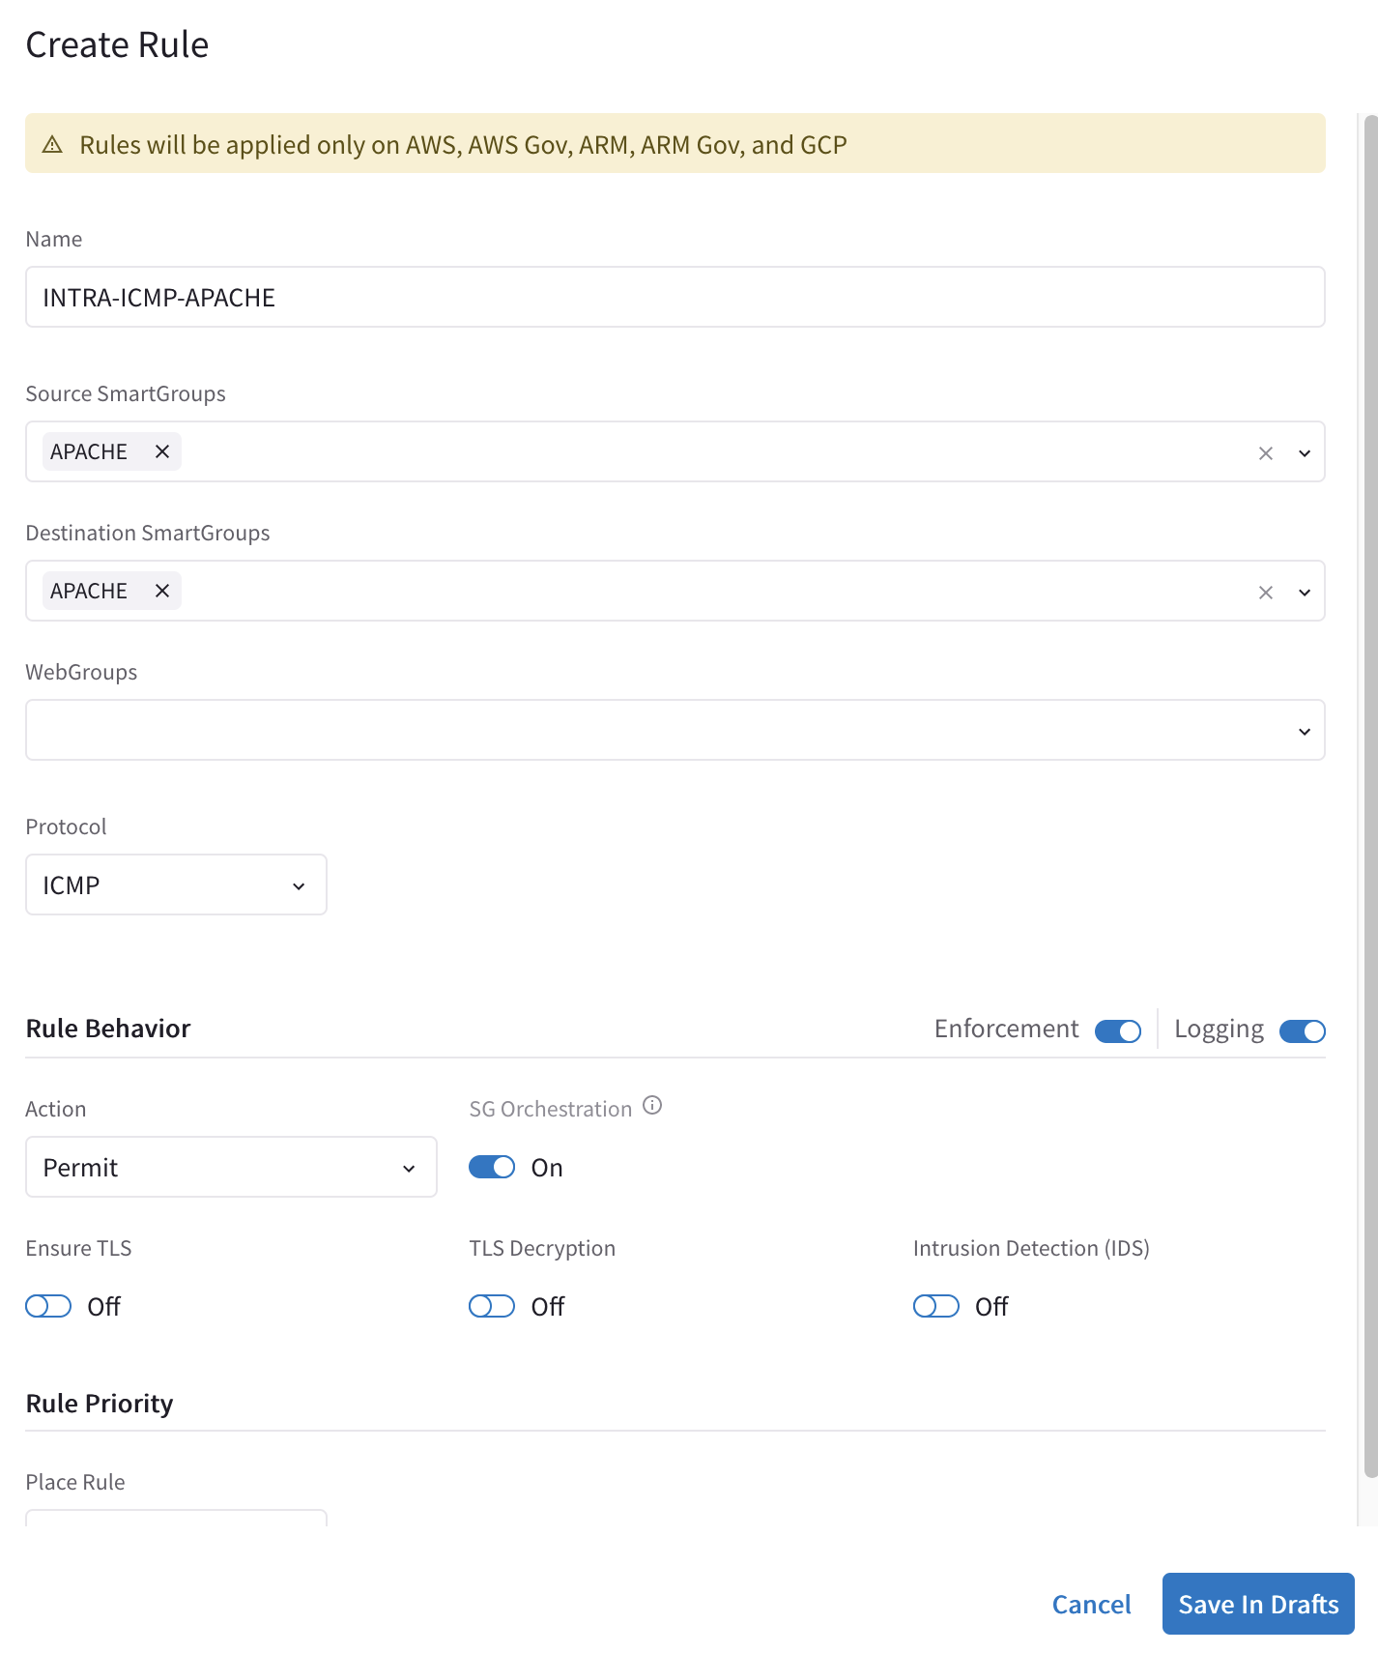
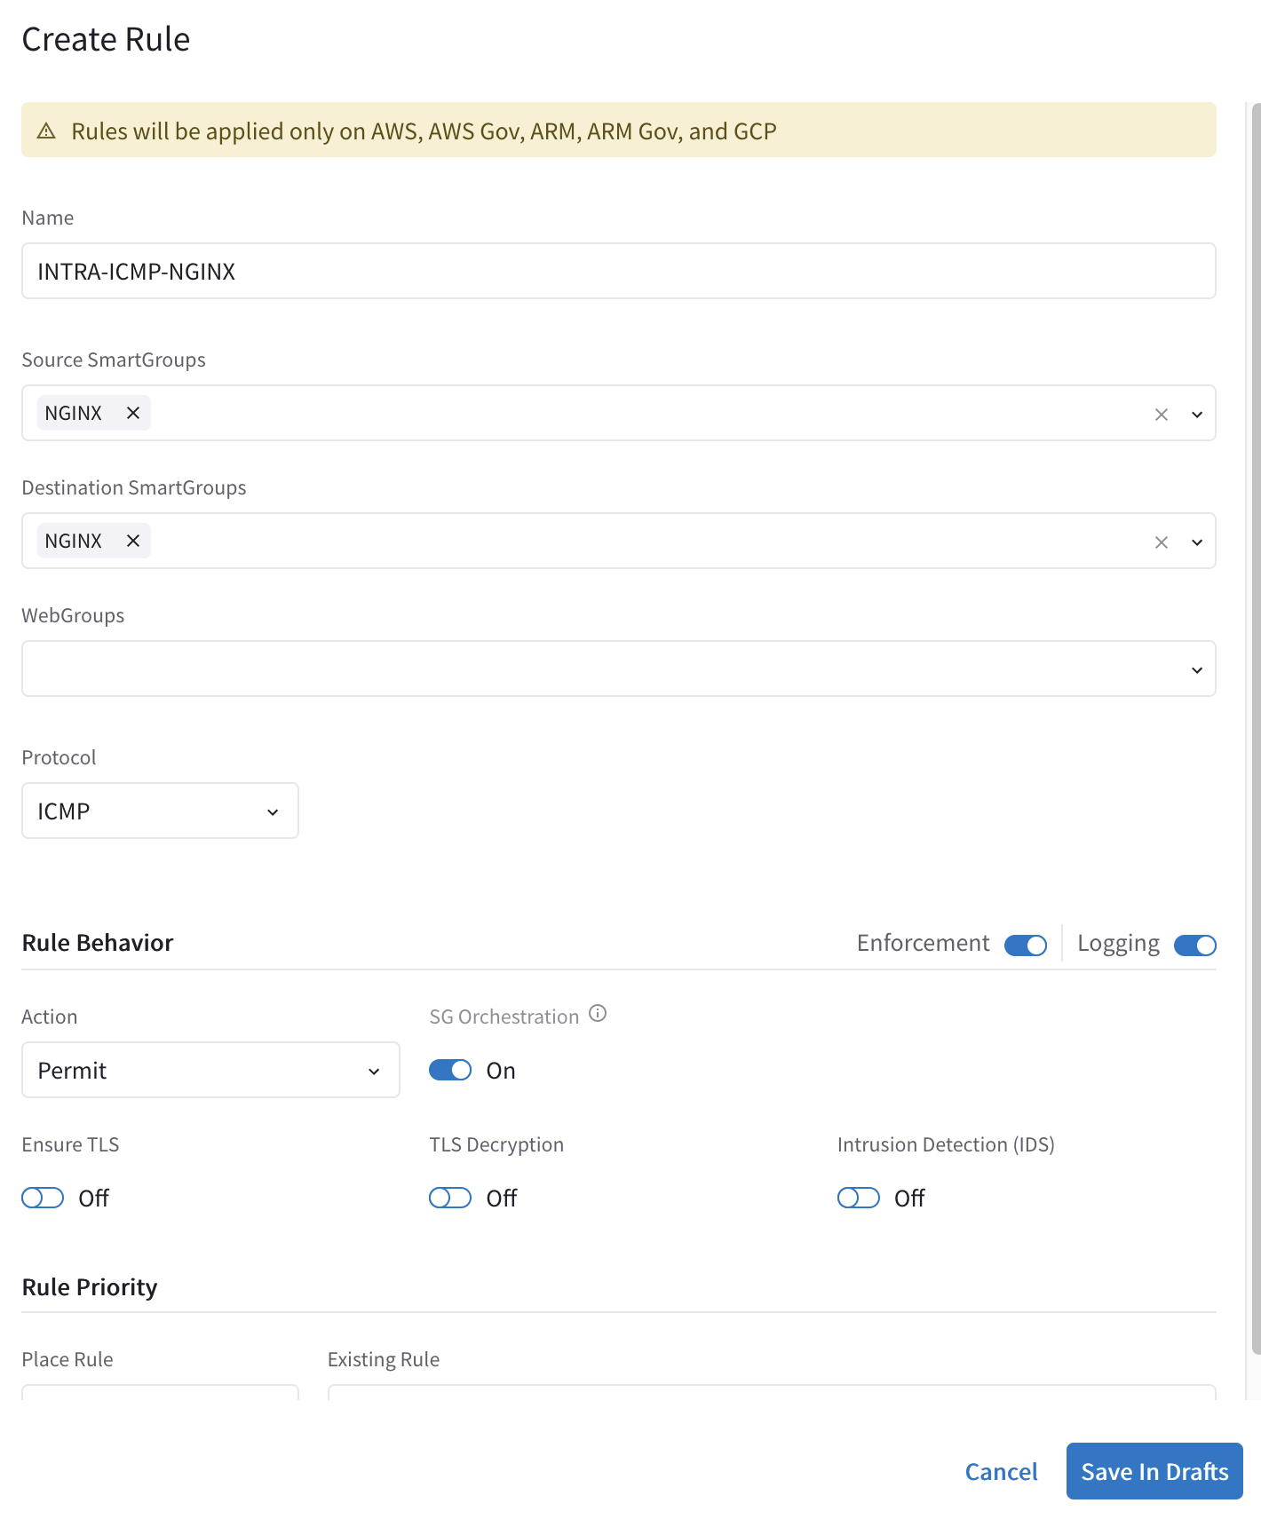
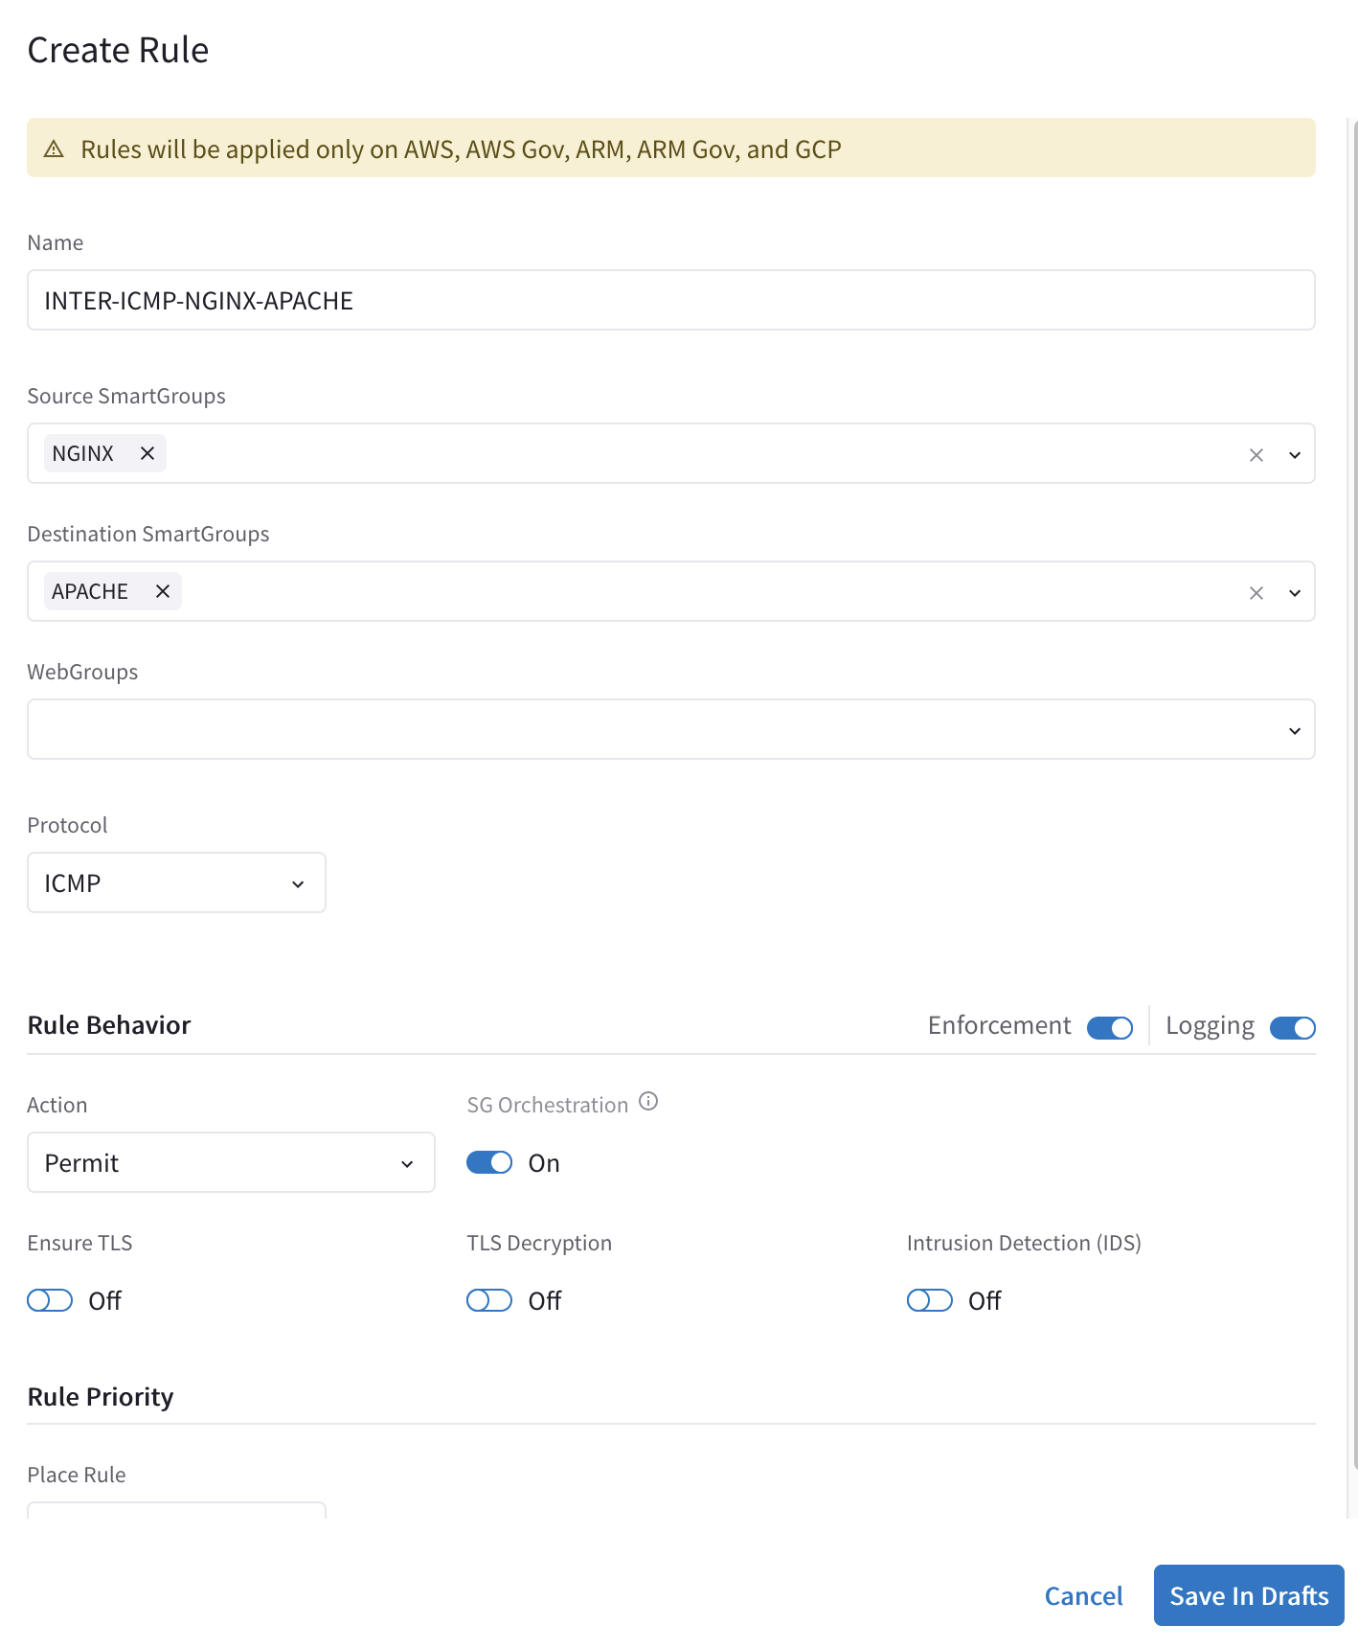

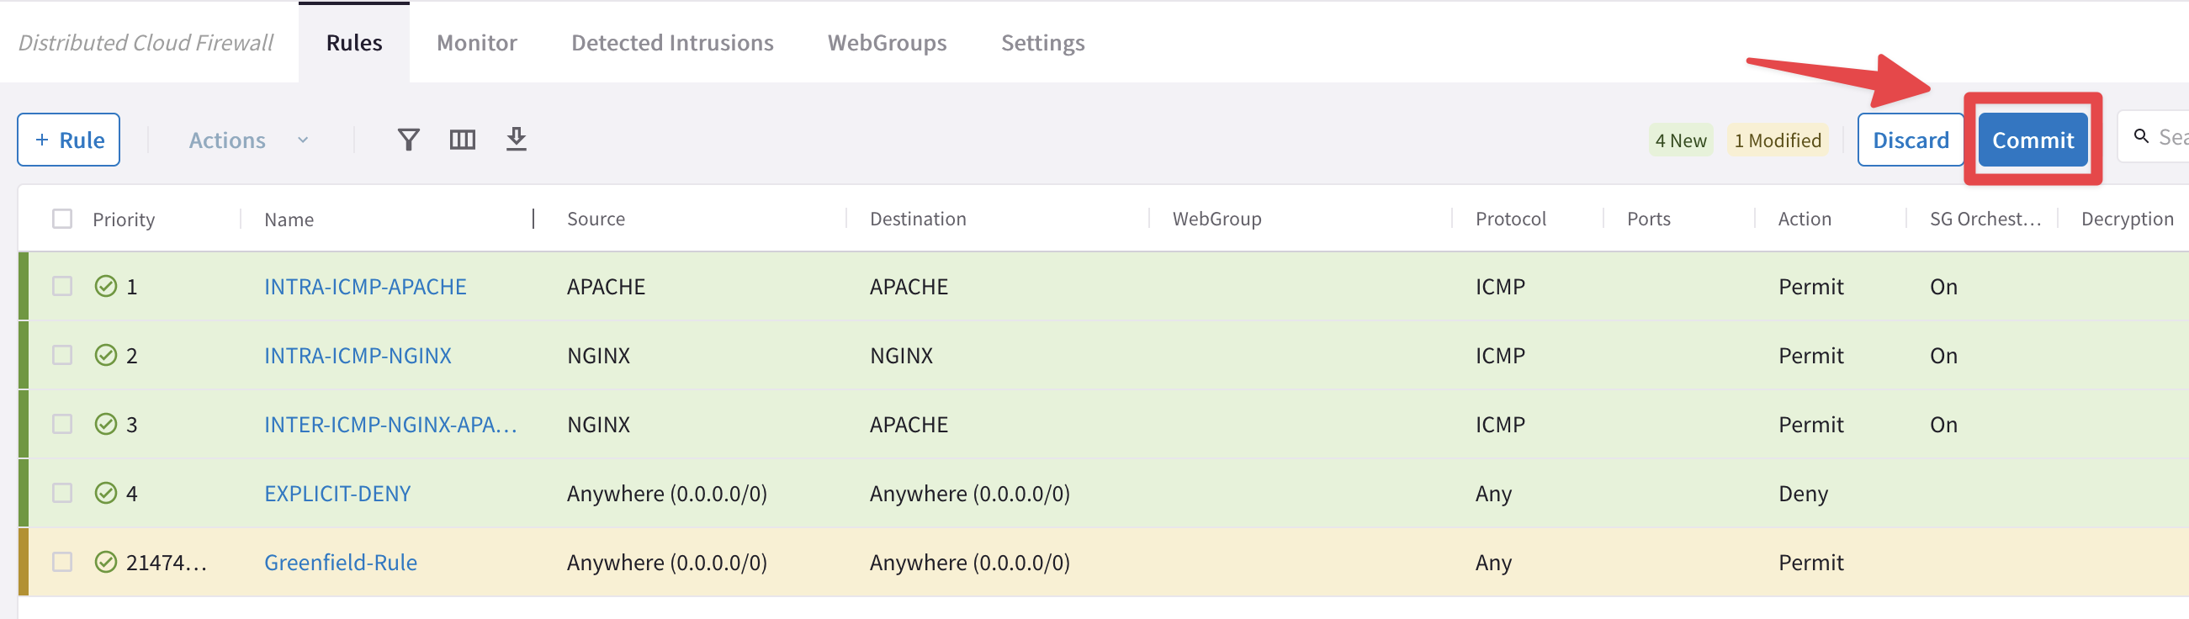
Micro-Segmention: SmartGroups, Intra-Rules and Inter-Rules
Intra-rule
SmartGroup
Nginx
Intra-rule
SmartGroup
Nginx
Inter-rule
SmartGroup
Apache
SmartGroup
Apache
VPC
VPC
VNet
Region 1
Region 2
Micro-Segmentation: Combination of SmartGroups and DCF Rules
Rule changes are saved in Draft state.
When you apply a rule to a SmartGroup, please keep in mind that there is an Invisible Hidden Deny at the very bottom.
To save the changes click on “Commit”
Discard will trash the changes
Rule is stateful, this means that the return traffic is allowed automatically
A rule between SGs can defined for achieving the INTER-SMARTGROUP communication
16

Slide 17
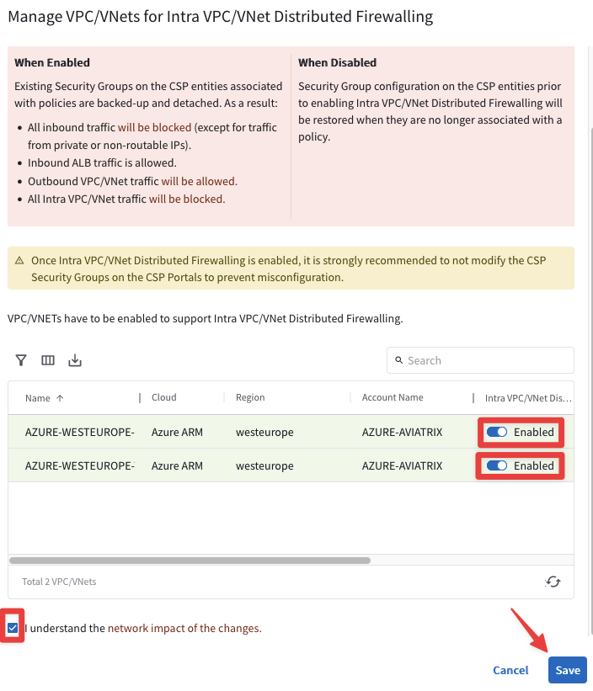
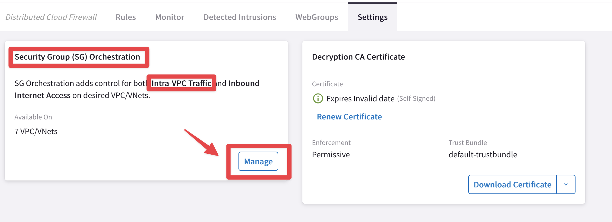
Intra VPC/VNET Distributed Firewalling (available on AWS/Azure)
Enable the feature on the relevant VNets
VNet
SmartGroup #1
SmartGroup #2
If you enable the Security Group orchestration (aka Intra-VPC Traffic Control), the SmartGroups will not be able to communicate with each other unless an inter rule is applied between them.
This is pure L4 separation using the Native Cloud Constructs (such as SG, NSG and ASG). This is not L7 inspection.
Future Implementation: traffic will be diverted to the nearby Spoke GW for the L7 inspection
Transit
Spoke

Slide 18
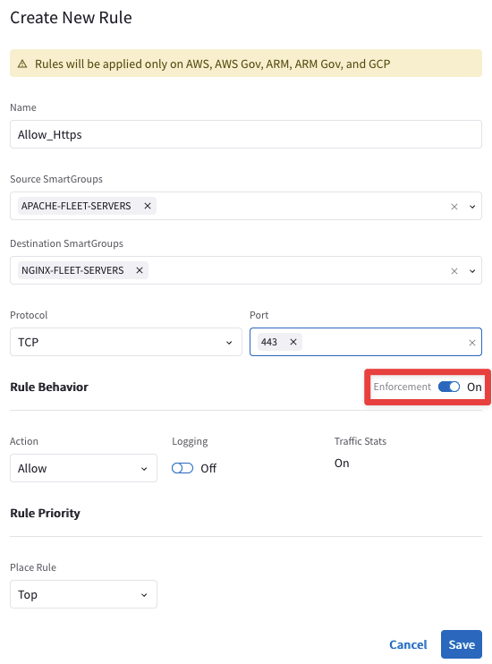
Rule Enforcement
Enforcement ON
Policy is enforced in the Data Plane
Enforcement OFF
Policy is NOT enforced in the Data Plane
The option provides a Watch/Test mode
Common use case is with deny rule
Watch what traffic hits the deny rule before enforcing the rule in the Data Plane.

Slide 19
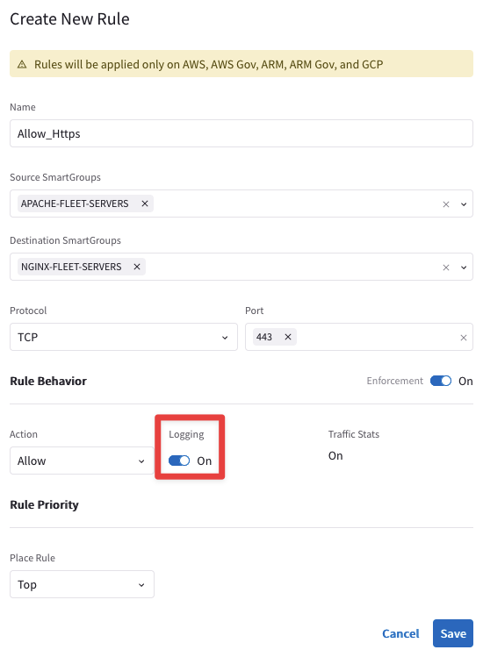
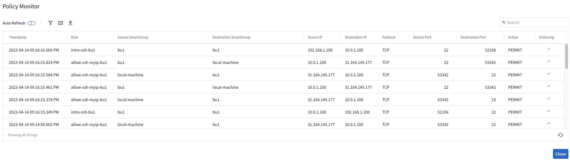
Rule Logging
Logging can be turned ON/OFF per rule
Configure Syslog to view the logs

Slide 20
Tools for troubleshooting Distributed Cloud Firewall

Slide 21
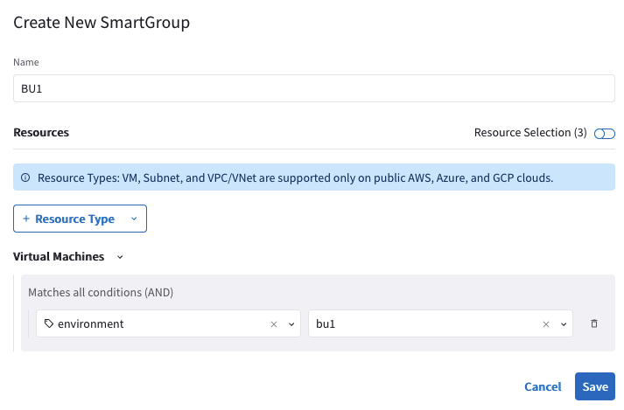
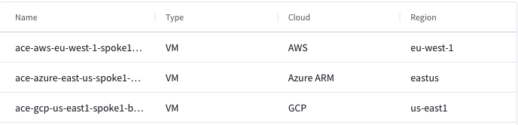
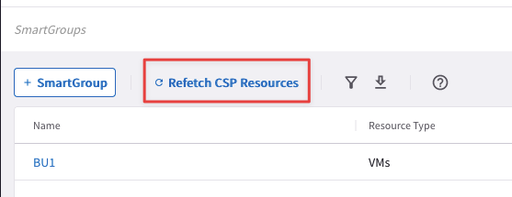
Creation of the SmartGroup: the right matching criteria dilemma
Choose the right matching criteria for resources that you want to see assigned to a specific SmartGroup:
Classification based on the CSP Tags
Classification based on the Resource Properties (i.e. Name, Region or Account Name)
Classification based on the IPs/CIDRs
Use the Preview Resources toggle switch to verify the selected resources that have been mapped to the Smart Group
Use the On-Demand Refetch CSP Resources button to retrieve the most recent inventory

Slide 22
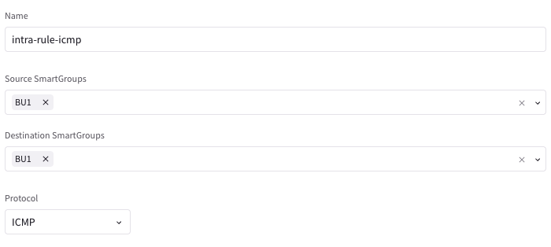
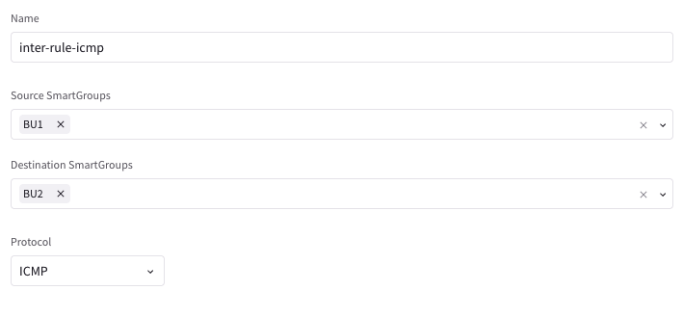
Creation of the Rules: intra-rule vs. inter-rule
Intra-rule will affect the traffic WITHIN a Smart Group
Source Smart Group and Destination Smart Group must be the same
Inter-rule will affect the traffic BETWEEN SmartGroups
Source Smart Group and Destination Smart Group must differ
CAVEAT – The Invisible Implicit Deny: as soon as a Rule is committed (either intra-rule or inter-rule) a hidden deny is applied at the bottom of your Rules list. The implicit deny is really an “invisible deny”; you won’t see a “deny any” line automagically added! Since you don’t see it, it’s easy to forget about. Forgetting about the implicit deny is the #1 reason for Distributed Firewalling Rule not giving you the desired results.

Slide 23
Next: Lab 8 Distributed Cloud Firewall

Slide 24
Additional Backup Slides

Slide 25

SmartGroup Design Best Practices
Dynamic SmartGroup Hierarchy
VPC/VNET
Tags at the VPC/VNET level and possibly the subnet level can be used for Guardrail policies since application owners don’t have IAM privileges to edit these tags. Examples include Lifecycle, Data Classification, etc.
IMPORTANT THINGS TO NOTE
Use Dynamic SmartGroups wherever possible.
Take advantage of the hierarchy in SmartGroup types to provide governance. Tags that an application owner should not be able to over-ride (such as PCI, Prod/Dev, etc.) should leverage VNET/VPC type smartgroups. RBAC can be applied to these tags via the CSP and inherited by the workloads. This enables a blend of developer controlled policy and security-controlled policies.
Currently VM-type smartgroups only work for IaaS/VMs. To capture PaaS you should use CIDR or Subnet-type SmatGroups.
SmartGroups could take several minutes to update upon tag changes or initial provisioning. For actions that have to happen at boot time, consider leveraging SmartGroups that are of the subnet/VNET type.
Subnet
VM
SmartGroups at the VPC/VNET and subnet level can be used to apply policy to PaaS.
Tags at the workload level will likely be used to defined “Application” and “Role” within the application.

Slide 26
Policy Design Best Practices
Example Hierarchical Section Design
Section (1-1999): Guardrail Exceptions and Global Allow Policies
Priority | Name | Src | Dst | Port/Proto | Action | Log
1 | GR-E-App1-Prod-Dev-DB | App1-Prod-Web | App1-Dev-DB | TCP/3306 | Allow | No
Aviatrix Native Firewalling has an implicit, partial Deny, but it is recommended to not rely on implicit policy. Instead, all policy should be explicitly authored for understandability.
The first policy written should be and explicit catch-all called “Global-Catch-All”. For brownfield it is recommended that this has an action of “allow”. The catch all should have a high priority number and be the last policy in the list.
Rules are evaluated in order and should have a naming convention that indicates their intent.
Internet Egress Policies
For Internet Traffic, use the “Public Internet” pre-defined Smartgroup introduced in 7.1 as the destination, NOT the 0.0.0.0/0 SmartGroup.
Internet Policies (especially if they contain webgroups) should be near the bottom of the list.
It’s possible to have a single base rule for HTTP and HTTPS and use inspection sub-rules to define more specific policies with FQDN/URL filtering (introduced in Egress 2.0)
It’s recommended that source not be a “VM Type” SmartGroup as the delay in recognizing a new VM could restrict bootstrapping. Instead, use a subnet, VNET, or CIDR type SmartGroup.
Each VPC/VNET will likely have their own catch all as you gradually introduce firewalling policy and enforce. VNET catch-alls should be a pair rules, one for Ingress, and one for Egress.
Logging. Best practice is to log Deny rules and Internet Egress rules. All other allows will be captured by FlowIQ.
Section (2000-3999): Guardrails
1002 | GR-Deny-Prod-Dev | Prod,Dev | Prod,Dev | Any | Deny | Yes
Section (5000-29999): Application Policies
10000 | App1-Policy-1 | Internet | App1-LB | TCP/443 | Allow | No
10001 | App1-Policy-2 | App1-LB | App1-Web | TCP/80 | Allow | No
10002 | App1-Policy-3 | App1-Web | App1-DB | TCP/3306 | Allow | No
Section (30000-34999): Explicit, Targeted Catch Alls
90000 | Deny-Catch-All-Ingress | Any | VNET1, VNET2 | Any | Deny | Yes
90001 | Deny-Catch-All-Egress | VNET1, VNET2 | Any | Any | Deny | Yes
Section (35000-35999): Internet Egress Policies
2000 | Egress-HTTP | Private-Networks | Public Internet | TCP/80 | Allow and Inspect | Yes
2001 | Egress-HTTPS | Private-Networks | Public Internet | TCP/443 | Allow, Inspect, Decrypt | Yes
Section (50000): Explicit Allow - Global Catch All
100000 | Global-Catch-All | Any | Any | Any | Deny | No

